Slide 1
Investigation of Multi user signal detection in large scale MU-MIMO systems
B. Tech ECE FINAL YEAR PROJECT –FINAL REVIEW
Faculty Guide
Prof. Kalapraveen Bagadi
13BEC0342-B.Sai Ram Susheel
13BEC0697-K.Sai Krishna Prasad

Slide 2
CURRENT STATUS AND MOTIVATION
Practical implementation of large multi-user MU-MIMO faces several signal processing challenges, including synchronization, channel state information (CSI) estimation, and signal detection.
One major problem is ﬁnding the best performance-complexity trade-off in the scope of signal detection.
In this work, we have studied various detection techniques say Zero Forcing, MMSE Maximum likelihood and LAS(Likelihood ascent search).
The main motivation is that to reduce complexity and increase the performance as here we are having different complexity issues with respect to different detection techniques.

Slide 3
OBJECTIVE
Employing a large number of users in the transmitting side(each user equipped with a single antenna) greater than that of the receiving side antennas, to gain a better spectral efficiency and capacity.
Employing different detection techniques
1)Zero Forcing 2)MMSE 3)Maximum likelihood 4)LAS
Here the above detection techniques are present for both MIMO(SDM) and also for MU-MIMO(SDMA)
Whereas another detection method namely LAS technique is employed only for antennas selection till date. Here our main objective is to employ this technique to MU-MIMO. As the above detection method has yielded better results in MIMO.
Here the main expected outcome of our application of this technique is to estimate the transmitted signal more appropriately with less complexity and to gain better performance say capacity and spectral efficiency.
Here this LAS technique has been used in massive mimo signal detection which reduces the complexity of ML.

Slide 4
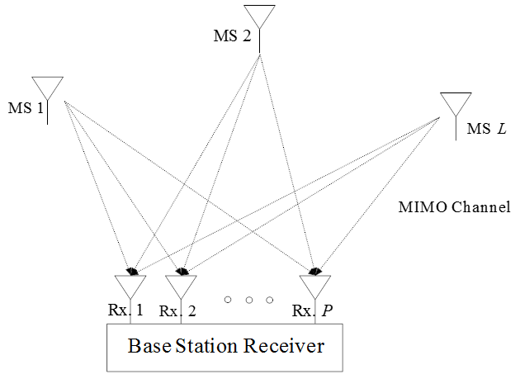
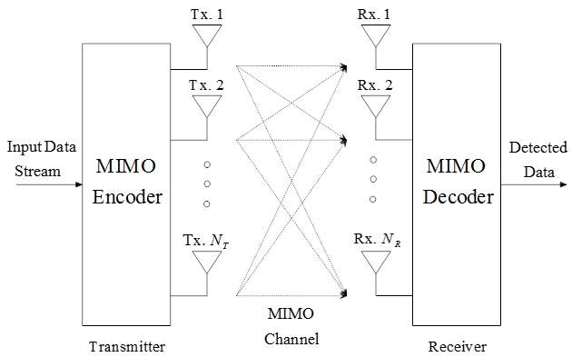
System Model
SDMA system model
SDM system model

Slide 5
DETECTION TECHNIQUES
1)Zero forcing
It is a linear detection technique
Taken in the form of Y=HX + N
Y→RECEIVED SIGNAL X→TRANSMITTED SIGNAL
H→CHANNEL MATRIX N→NOISE
where represents the IFFT length, M is number of propagation paths and is time domain channel gain of link between pth receiving antenna and lth user.
The equation is where , where is the pseudo inverse of H.
Here we neglect noise in the above equation so we wont get a appropriate detection of the transmitted signal.

Slide 6
DETECTION TECHNIQUES
2)MMSE
It is also a linear detection technique
Taken in the form of
Y→RECEIVED SIGNAL X→TRANSMITTED SIGNAL
H→CHANNEL MATRIX N→NOISE IPP -> P-dimensional identity matrix
Sigma square is noise variance H^H-->Hermitian transpose
Here we take noise in the above equation but the problem is at high SNR value the noise power is negligible and vice versa .So at high SNR value this technique gets equal to that of the Zero forcing.
This works at only low and medium SNR values.

Slide 7
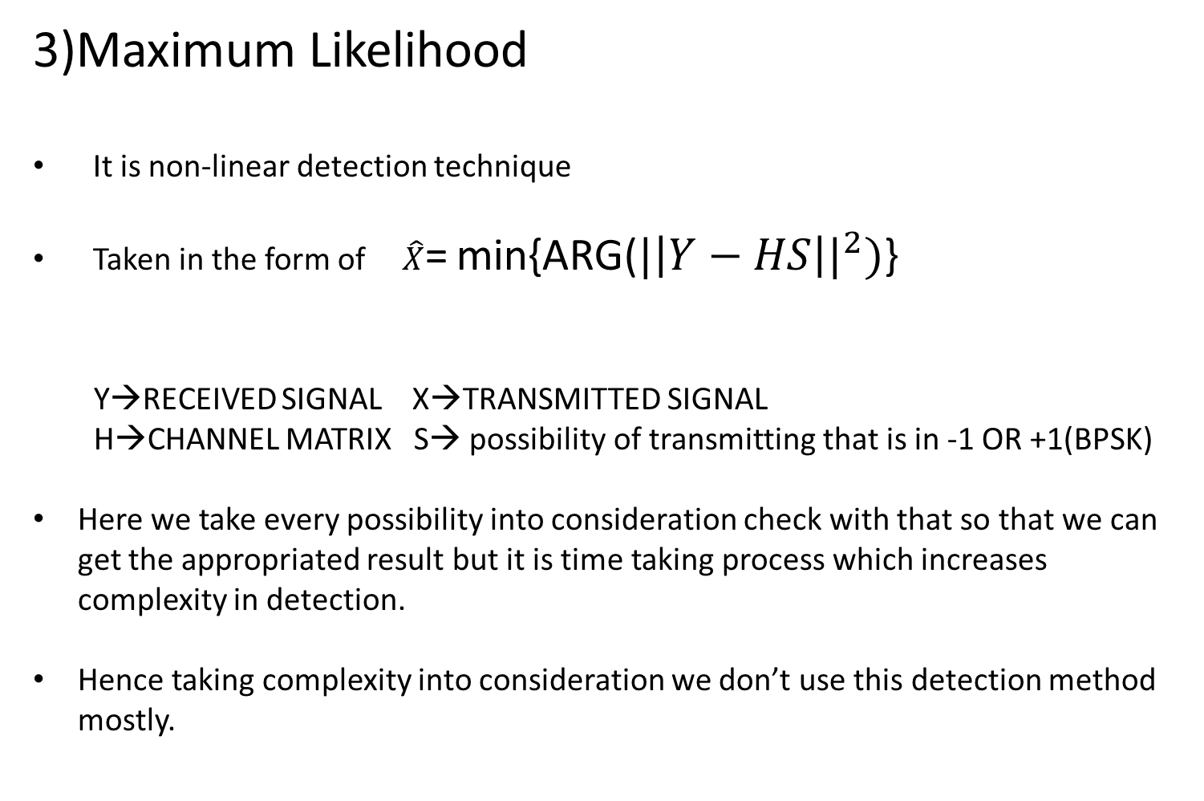
DETECTION TECHNIQUES
3)Maximum Likelihood
It is non-linear detection technique
Taken in the form of $\hat{X}$= min{ARG(${|\left|Y−HS\right||}^{2})$}
Y→RECEIVED SIGNAL X→TRANSMITTED SIGNAL
H→CHANNEL MATRIX S→ possibility of transmitting that is in -1 OR +1(BPSK)
Here we take every possibility into consideration check with that so that we can get the appropriated result but it is time taking process which increases complexity in detection.
Hence taking complexity into consideration we don’t use this detection method mostly.

Slide 8
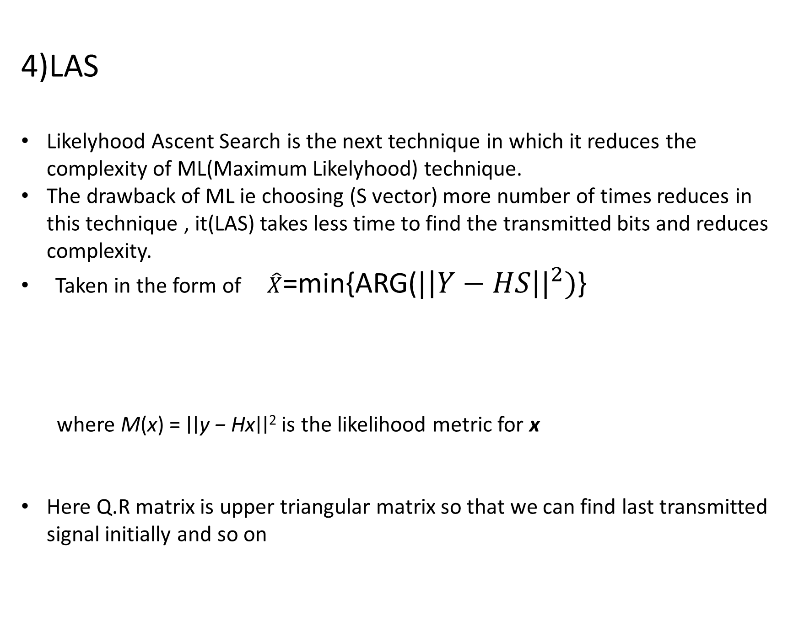
DETECTION TECHNIQUES
4)LAS
Likelyhood Ascent Search is the next technique in which it reduces the complexity of ML(Maximum Likelyhood) technique.
The drawback of ML ie choosing (S vector) more number of times reduces in this technique , it(LAS) takes less time to find the transmitted bits and reduces complexity.
Taken in the form of $\hat{X}$=min{ARG(${|\left|Y−HS\right||}^{2})$}
where M(x) = ∣∣y − Hx∣∣² is the likelihood metric for x
Here Q.R matrix is upper triangular matrix so that we can find last transmitted signal initially and so on

Slide 9
HARDWARE /SOFTWARE DETAILS
MATLAB

Slide 10
PARAMETERS
Table 2.1: Basic simulation parameters of the SDMA–OFDM with classical MUDs
Parameters | Value
Data frame size (N_{F}) | 1000
Number of data frames (N_{D}) | 1000
Modulation technique | BPSK
Number of Receiving Antennas (P) | 128
Number of Users (L) | 128
Channel | Rayleigh Flat Fading

Slide 11
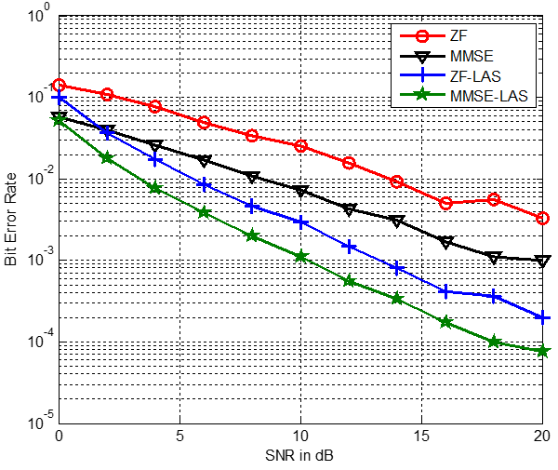
RESULTS
Figure 2: Average BER performance of all 64 users using various MUDs for a MU-MIMO system with 128 receiving antennas

Slide 12
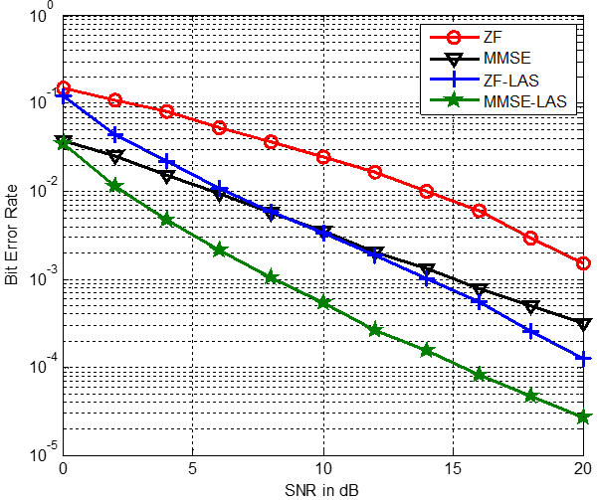
RESULTS
Figure 3: Average BER performance of all 128 users using various MUDs for a MU-MIMO system with 128 receiving antennas

Slide 13
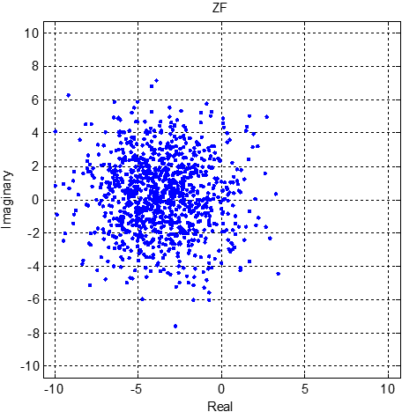
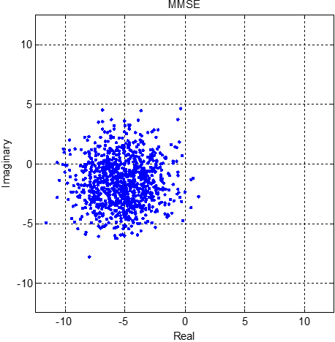
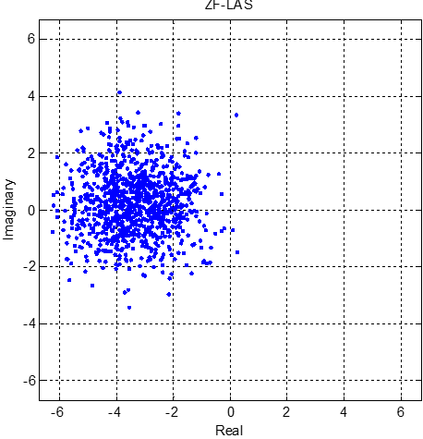
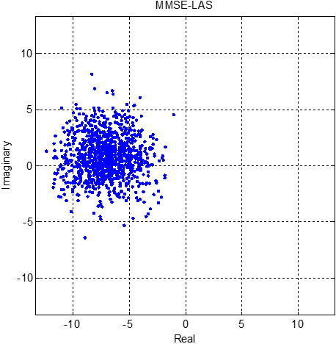
RESULTS
Figure 4: Estimated symbol distribution of User-1 using various MUDs when User-1 is always transmitting ‘–1’ at 10 dB SNR value (a) ZF (b) MMSE (c) ZF-LAS (d) MMSE-LAS

Slide 14
RESULTS
Table 2: Complexity comparisons
Multiuser Detector | Complexity order
ZF | N_{F} × N_{D}
MMSE | N_{F} × N_{D}
ZF-LAS,MMSE-LAS | N_{F} × N_{D} × L×m
ML | N_{F} × N_{D} × 2^{mL}

Slide 15
REFERENCES
[1] A. Chockalingam and B. S. Rajan, Large MIMO Systems. Cambridge, U.K.: Cambridge Univ. Press, 2014. [2] T. Datta, N. Srinidhi, A. Chockalingam, and B. Rajan, “Low-complexity near-optimal signal detection in underdetermined large-MIMO systems,” in Proc. Nat. Conf. Commun. (NCC), Feb. 2012, pp. 1–5.
[3] M. Zorzi, A. Gluhak, S. Lange, and A. Bassi, “From today’s INTRAnet of things to a future INTER net of things :A wireless-and mobility-related view,” IEEE Wireless Commun., vol. 17, no. 6, pp. 44–51, Dec. 2010.
[4] S. Buzzi, M. Lops, and S. Sardellitti, “Widely linear reception strategies for layered space-time wireless communications,” IEEE Trans. Signal Process., vol. 54, no. 6, pp. 2252–2262, Jun. 2006.
[5] S. Buzzi, H. Poor, and A. Zappone, “Transmitter waveform and widely linear receiver design: Noncooperative games for wireless multipleaccess networks,” IEEE Trans. Inf. Theory, vol. 56, no. 10, pp. 4874– 4892, Oct. 2010.
[6] C.Pietsch,S.Sand,W.Teich,andJ.Lindner,“Modeling and performance evaluation of multiuser MIMO systems using real-valued matrices ,”IEEE J. Sel. Areas Commun., vol. 21, no. 5, pp. 744–753, Jun. 2003.
[7] S. Buzzi and M. Lops, “Performance analysis for the improved linear multiuser detectors in BPSK-modulated DS-CDMA systems,” IEEE Trans. Commun., vol. 51, no. 1, pp. 37–42, Jan. 2003.
[8] P. Chevalier and F. Pipon, “New insights into optimal widely linear array receivers for the demodulation of BPSK, MSK, and GMSK signals corrupted by noncircular interferences—Application to SAIC,” IEEE Trans. Signal Process., vol. 54, no. 3, pp. 870–883, Mar. 2006.
[9] R. Meyer, W. Gerstacker, R. Schober, and J. Huber, “A single antenna interference cancellation algorithm for increased GSM capacity,” IEEE Trans. Wireless Commun., vol. 5, no. 7, pp. 1616–1621, Jul. 2006.
[10] M. Konrad and W. Gerstacker, “Interference robust transmission for the downlink of an OFDM-based mobile communications system,” EURASIP J. Wireless Commun. Netw., vol. 2008, pp. 1–14, 2008.

